Slide 1
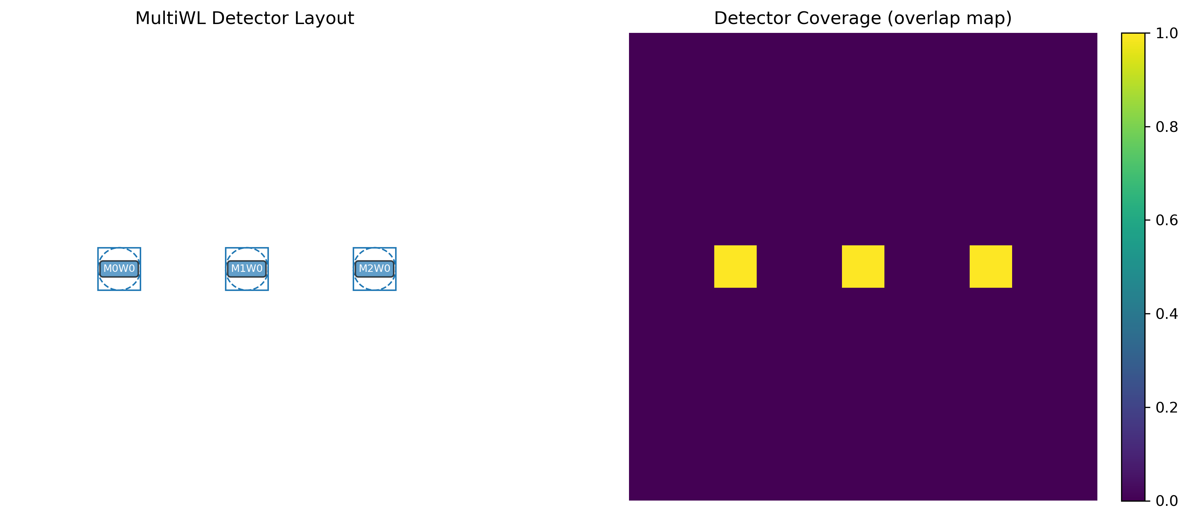
1550 3 modes

Slide 2
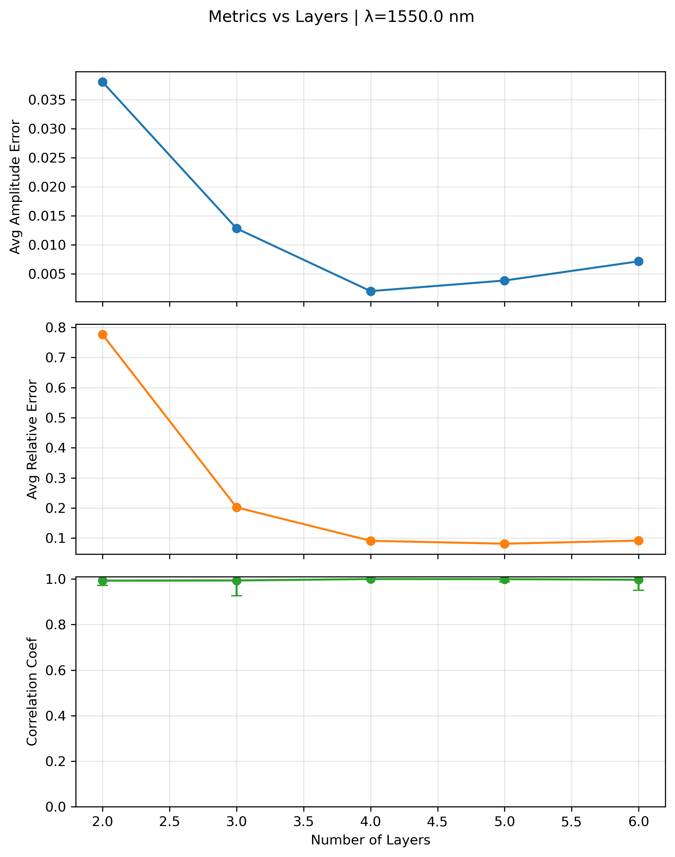
1550nm 3 modes

Slide 3
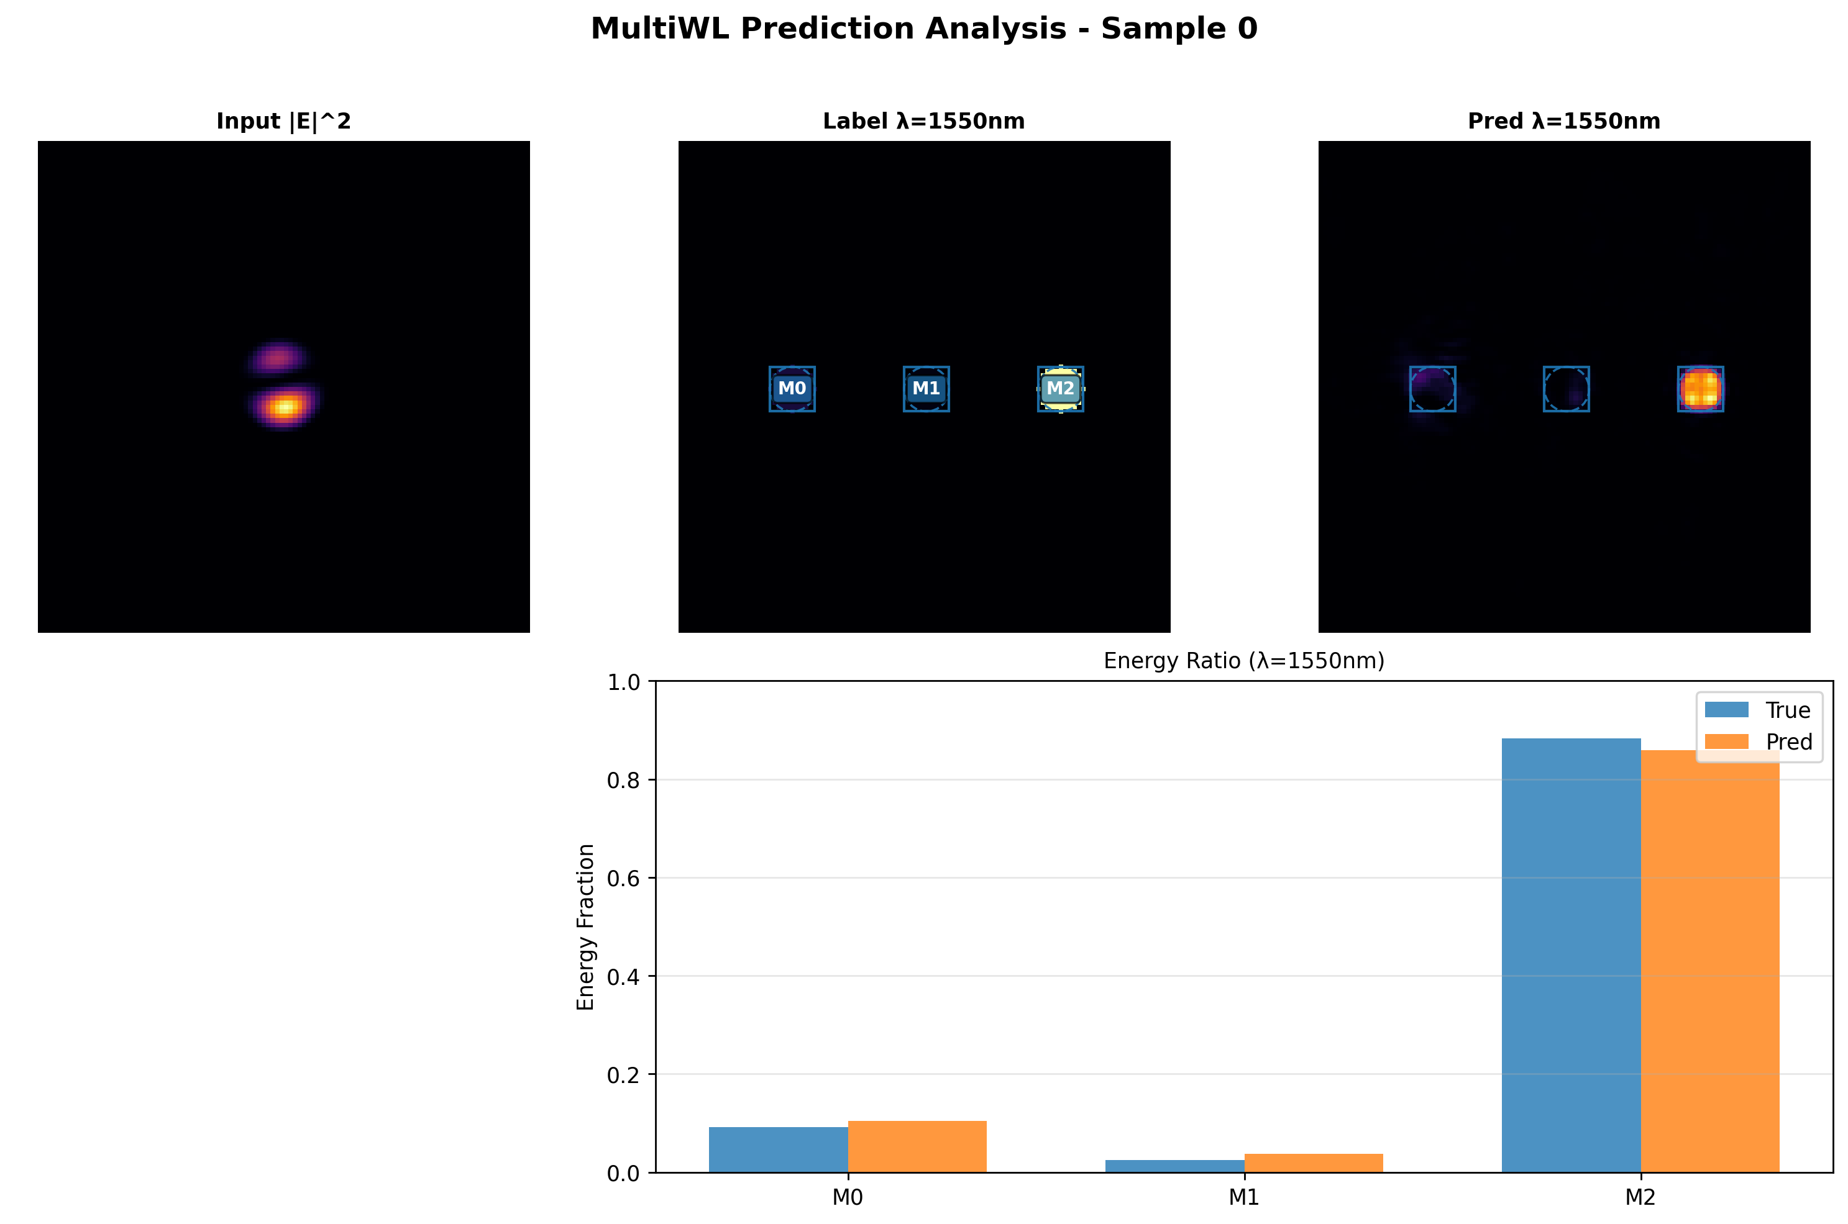
1550nm 3 modes layer 2

Slide 4

1550nm 3 modes layer 3

Slide 5
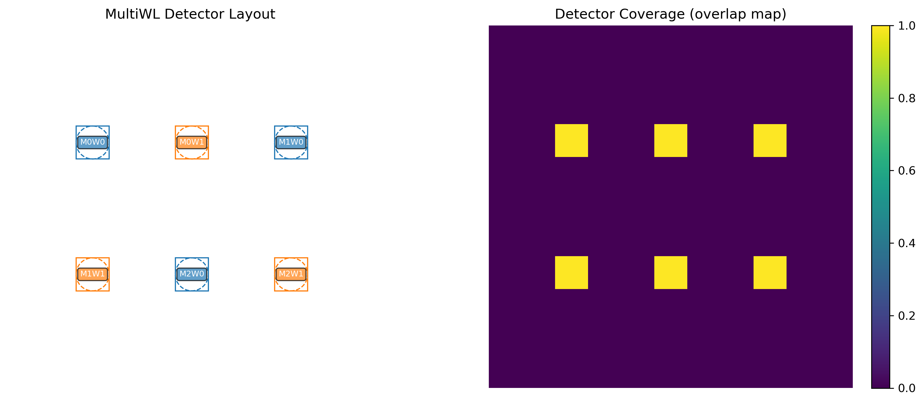
650nm 1568nm 3 modes

Slide 6
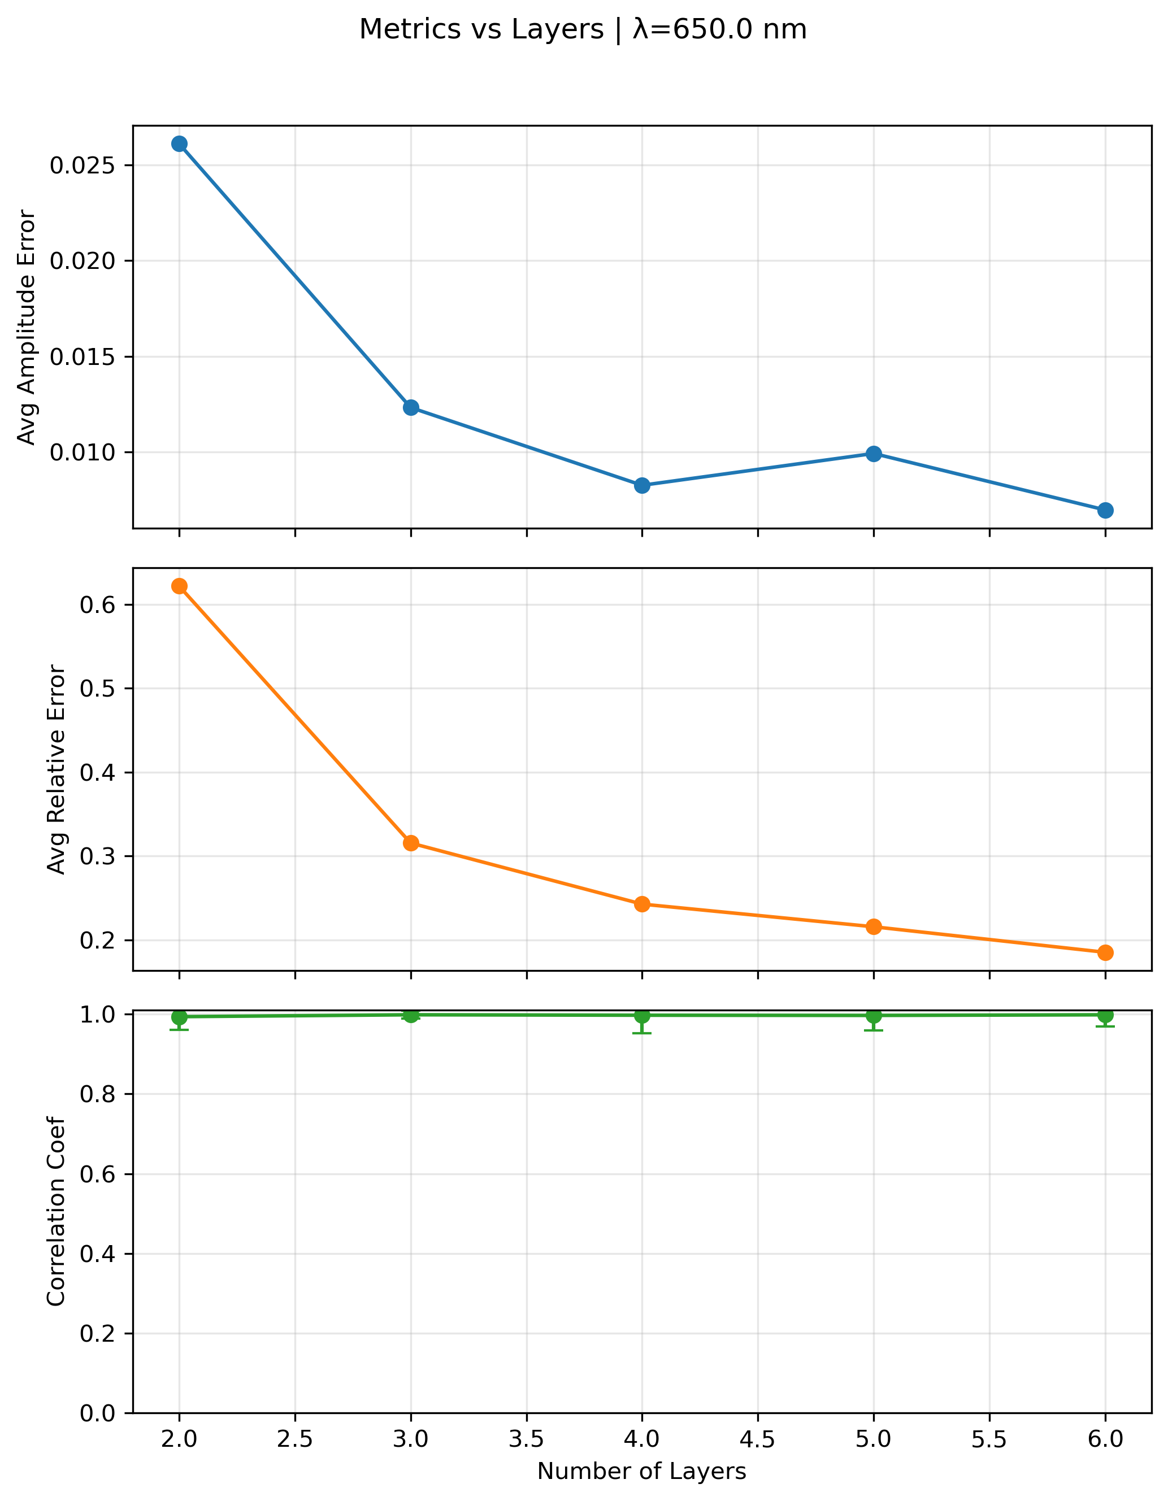
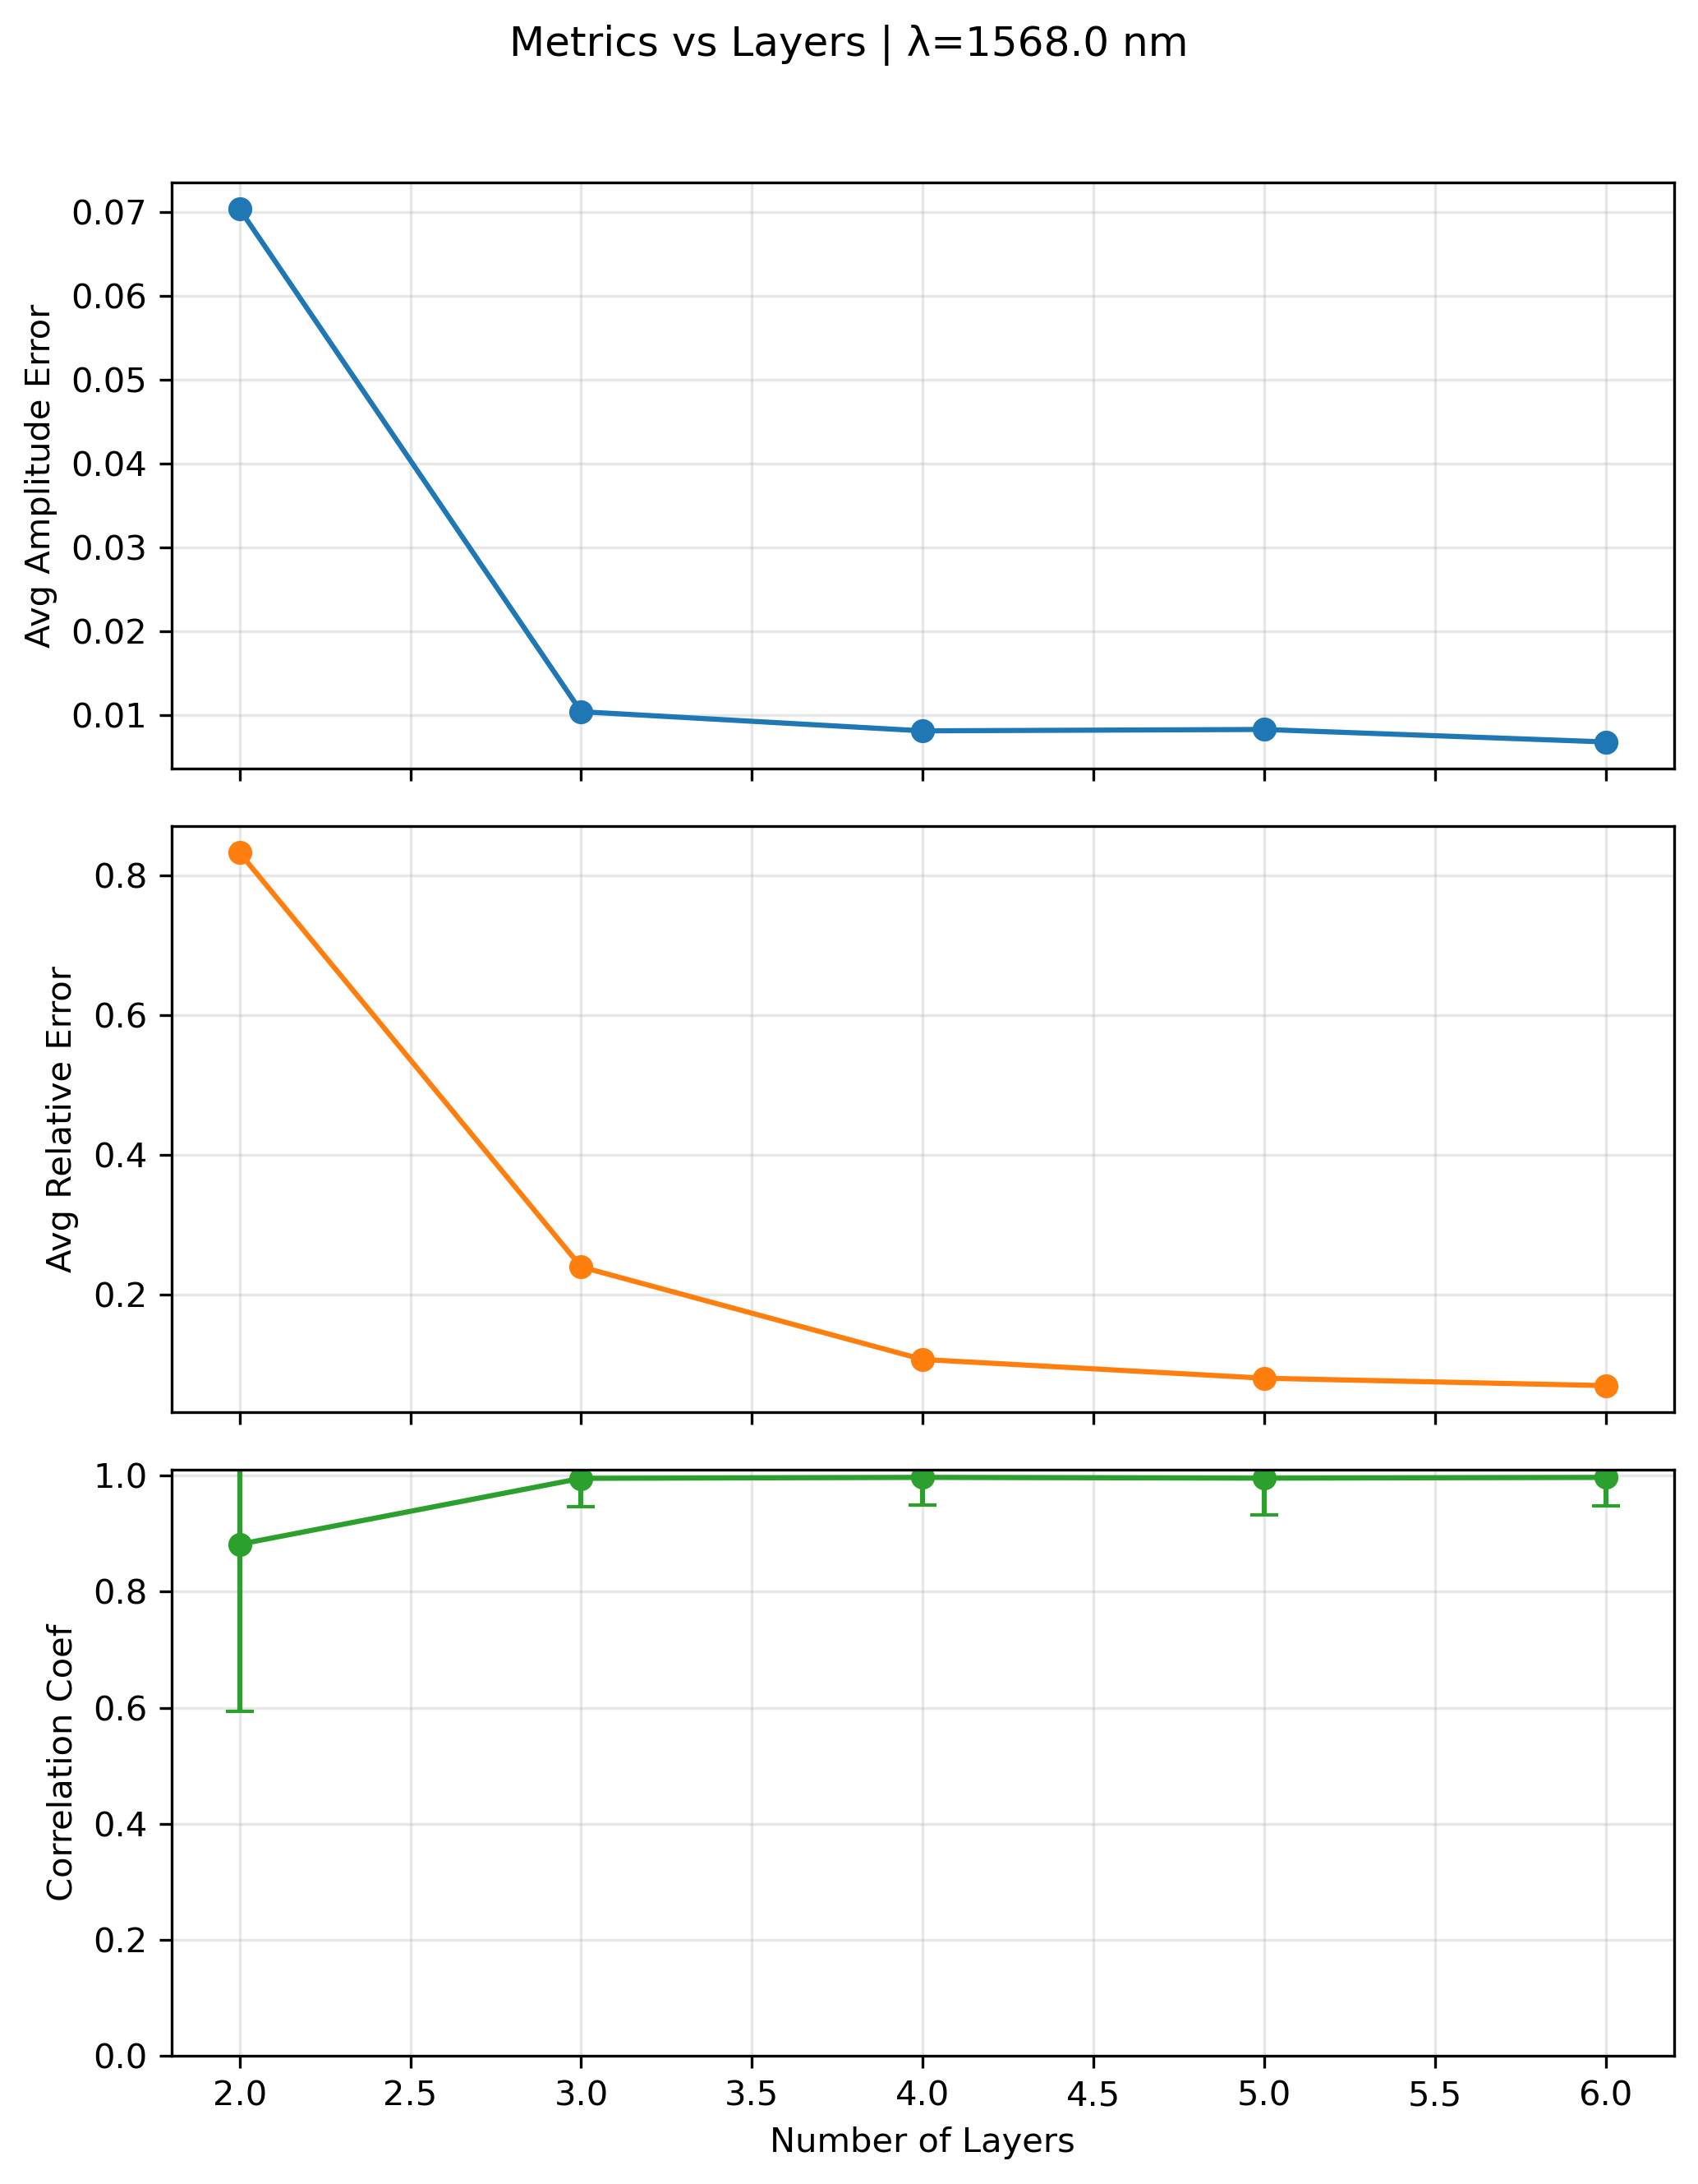
650nm 1568nm 3 modes

Slide 7
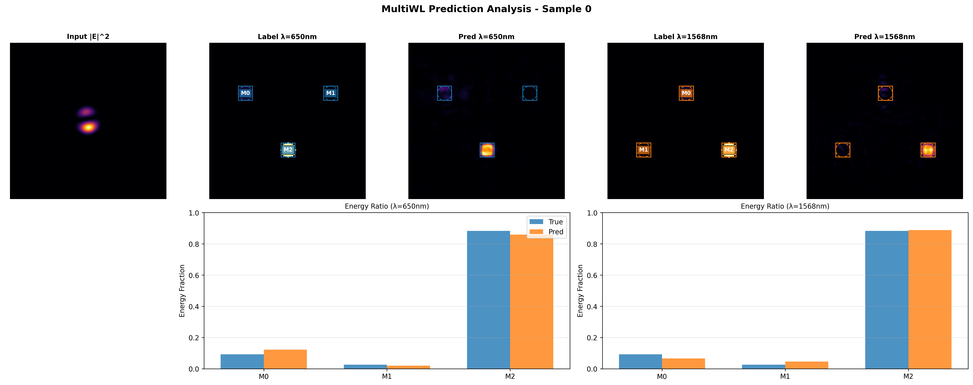
650nm 1550nm 3 modes L2

Slide 8
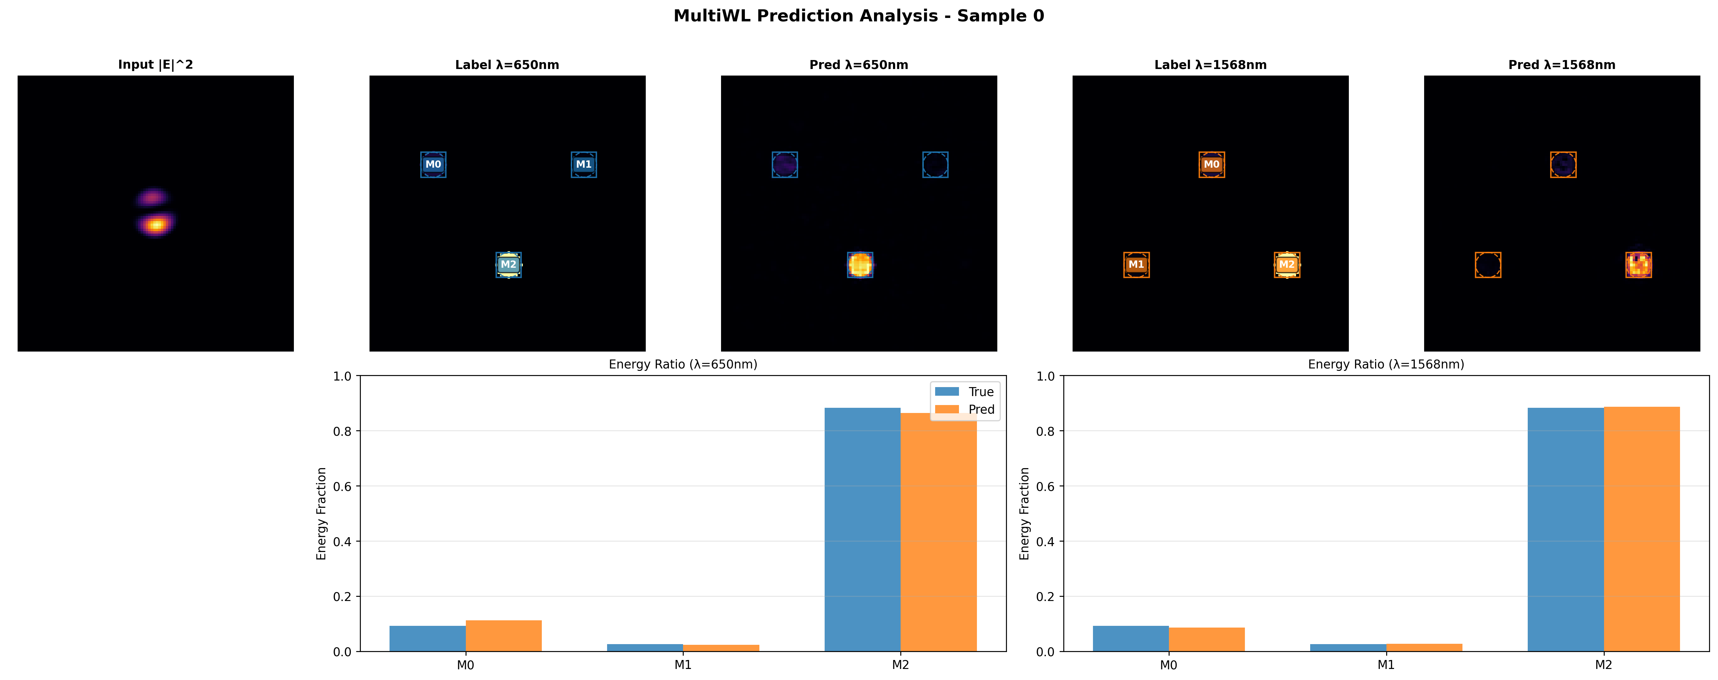
650nm 1550nm 3 modes L3

Slide 9
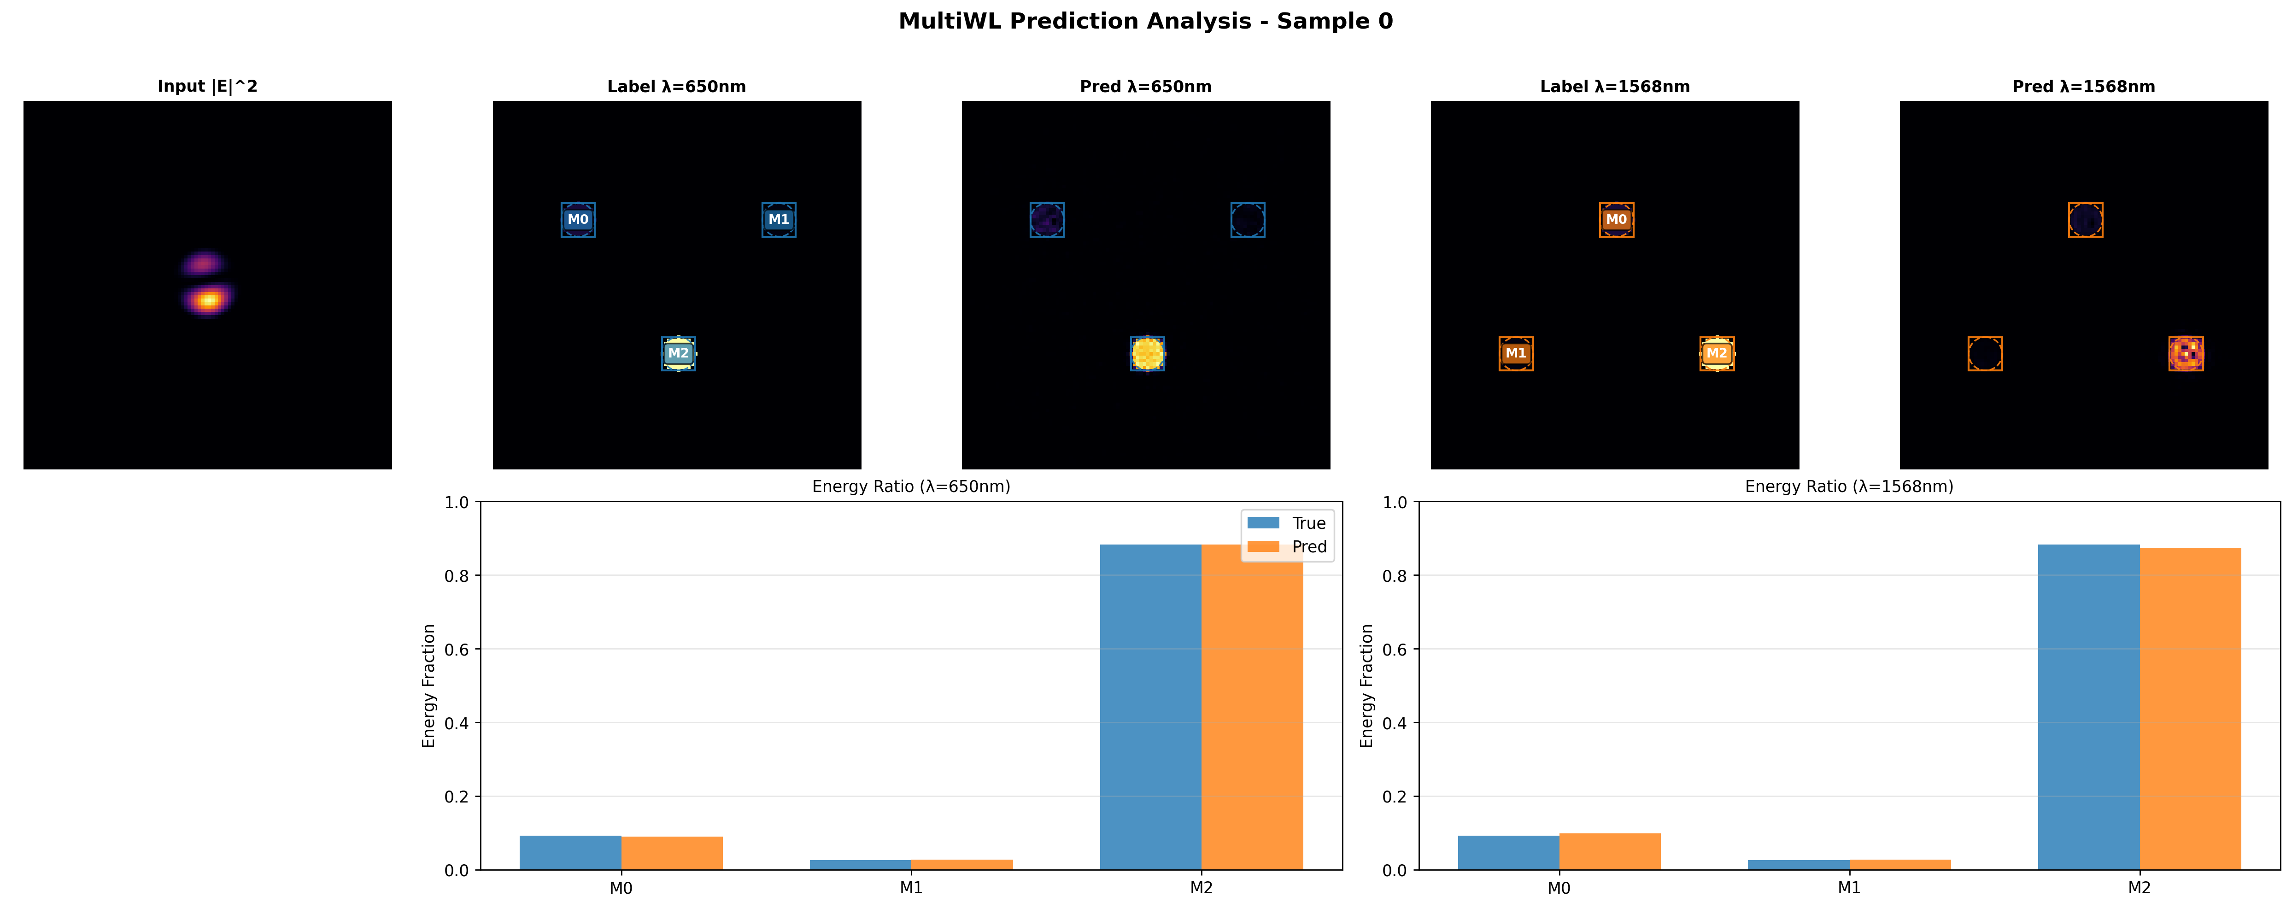
650nm 1550nm 3 modes L4

Slide 10

650nm 1550nm 3 modes L5

Slide 11

650nm 1550nm 3 modes L6

Slide 12
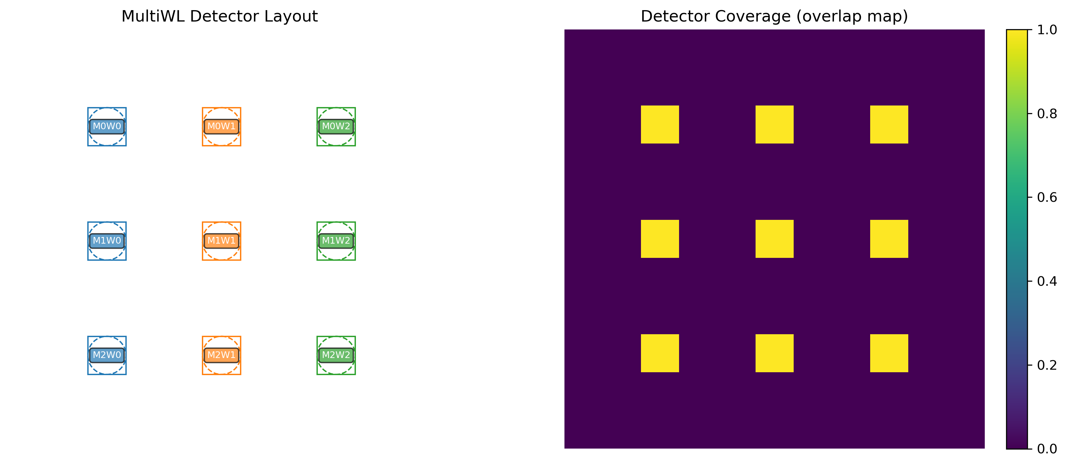
1550nm 1568nm 1650nm 3 modes

Slide 13
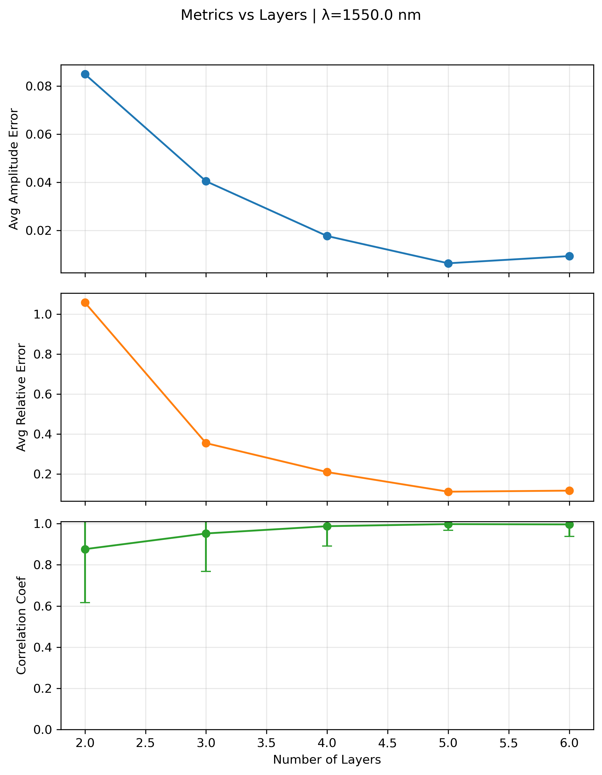
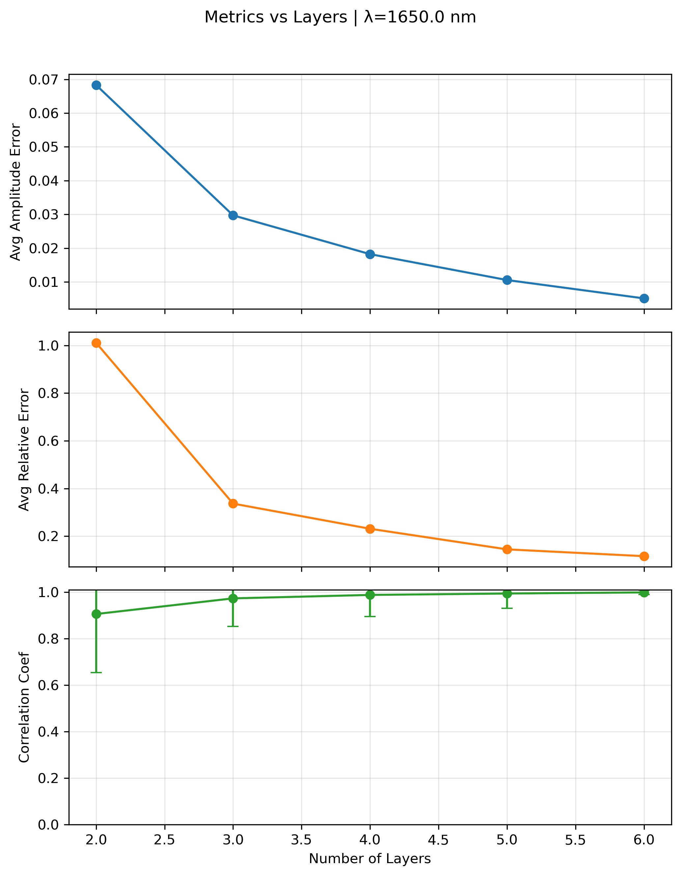
1550nm 1568nm 1650nm 3 modes

Slide 14
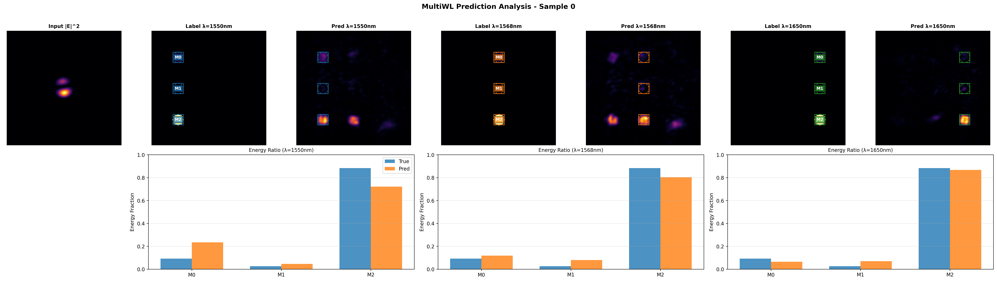
1550nm 1568nm 1650nm 3 modes L2

Slide 15
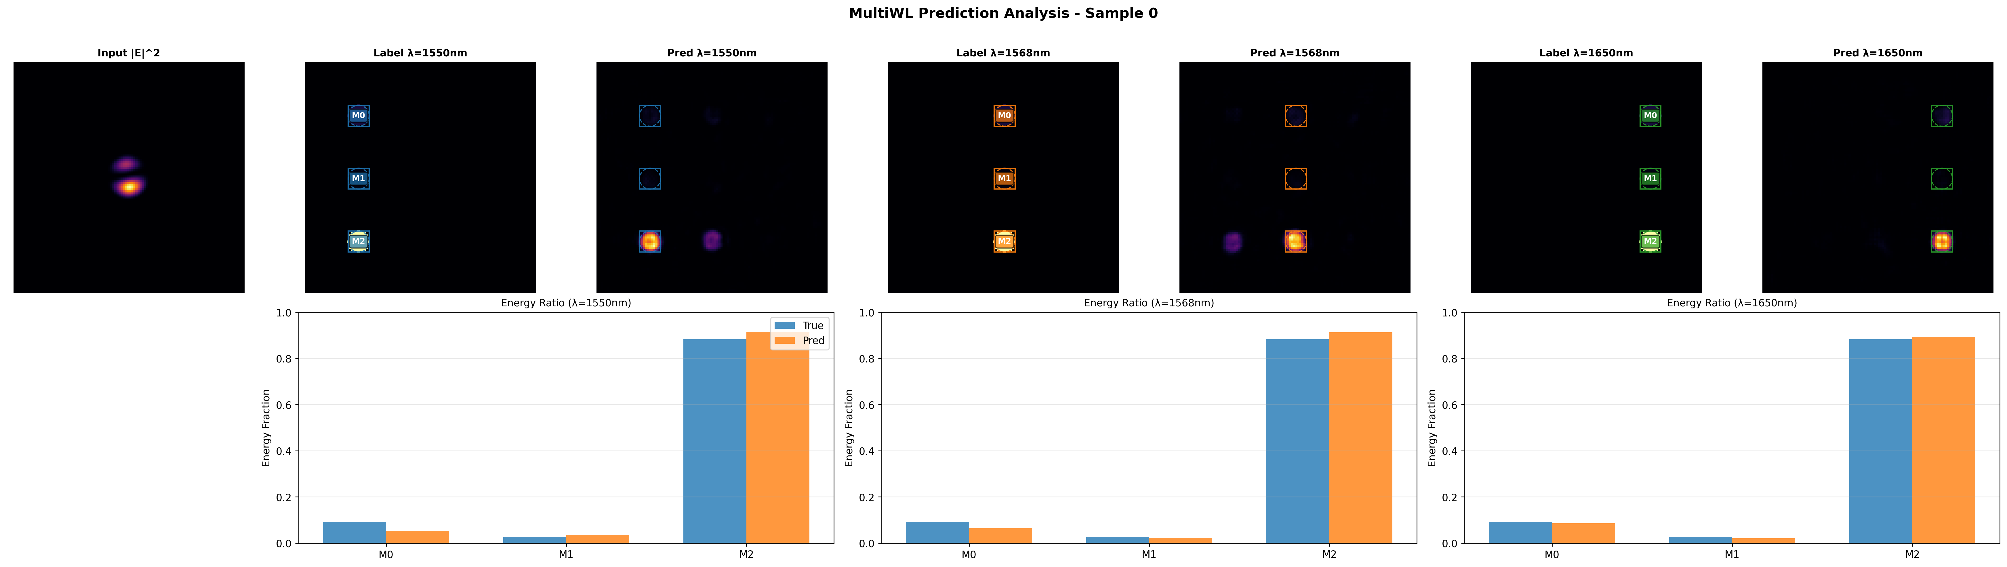
1550nm 1568nm 1650nm 3 modes L3

Slide 16
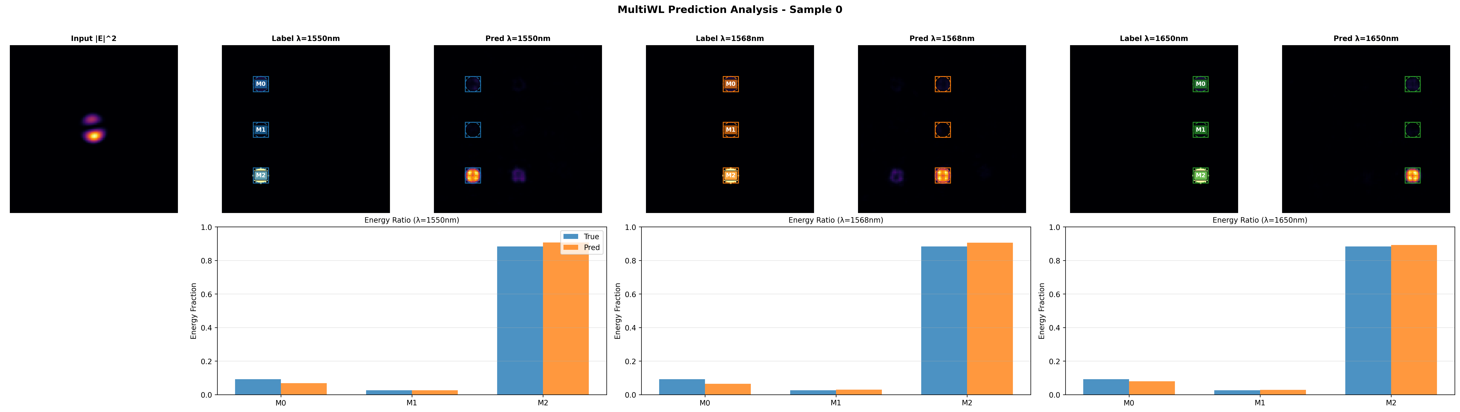
1550nm 1568nm 1650nm 3 modes L4

Slide 17

1550nm 1568nm 1650nm 3 modes L5

Slide 18

1550nm 1568nm 1650nm 3 modes L6

